Slide 1
ROC Company analysis
Model analysis

Slide 2
Introduction
Informed Decision-Making: Data analysis allows businesses to make informed decisions based on facts and evidence rather than intuition. It helps in identifying trends, patterns, and insights that can guide strategic choices.
Improved Efficiency: By analyzing data, businesses can identify inefficiencies in their operations and processes. This leads to streamlined operations, reduced costs, and improved resource allocation.
Competitive Advantage: Data analysis provides a competitive edge. Businesses that can effectively leverage data are better positioned to respond to market changes, customer preferences, and emerging trends, giving them a competitive advantage.
Customer Insights: Analyzing customer data helps businesses understand their customers' needs, preferences, and behavior. This knowledge is invaluable for tailoring products, services, and marketing efforts to specific target audiences
Risk Management: Data analysis helps in identifying and mitigating risks. By assessing historical data and predictive analytics, businesses can make informed choices to minimize potential risks and losses..

Slide 3
Dataset overview
Data Points or Observations: These are individual items or records. For example, in a dataset of sales transactions, each sale is a data point.
Attributes or Features: These are the characteristics or properties of each data point. In a dataset of people, attributes could include age, gender, income, etc.
Values: Each data point's attributes have associated values. For instance, the age of a person, the price of a product, or the temperature on a specific date.
Structure: Datasets have a specific structure. Some datasets are tabular, like spreadsheets, while others may be organized differently, such as text data, images, time series, or graphs.
Metadata: Information about the dataset itself, including the source, collection method, and a description of the attributes, is often included. This metadata is crucial for understanding and using the data effectively.

Slide 4
Classification problem
Classes or Categories: Classification problems involve multiple classes or categories that data points can be assigned to. For example, classifying emails as spam or not spam, identifying different species of flowers, or classifying images as cats or dogs.
Labeled Training Data: In supervised classification, a training dataset is used to teach the algorithm how to make predictions. Each data point in the training dataset is labeled with its correct class.
Predictive Model: The goal of a classification problem is to build a predictive model that can generalize from the training data to make accurate predictions on new, unseen data points.
Performance Metrics: Classification models are evaluated using various metrics such as accuracy, precision, recall, F1-score, and ROC-AUC, depending on the specific problem and class distribution.

Slide 5
Data preprocessing
Data Cleaning:
Handling Missing Values: Identify and deal with missing data, which can be done by imputing missing values or removing records with missing data.
Outlier Detection and Handling: Identify and address outliers that can skew analysis or modeling results.
Noise Reduction: Remove or smooth noisy data points to improve the quality of the dataset.
Data Transformation:
Scaling: Standardize or normalize numerical features to have similar scales. Common methods include Min-Max scaling or z-score standardization.
Encoding Categorical Data: Convert categorical data (text or non-numeric data) into numerical format using techniques like one-hot encoding or label encoding.
Data Discretization: Group continuous data into discrete bins or categories when necessary.
Feature Engineering: Create new features or variables that can provide additional information for analysis or modeling.
Data Reduction:
Dimensionality Reduction: Use techniques like Principal Component Analysis (PCA) or t-SNE to reduce the number of features while preserving the most important information.
Sampling: In some cases, reduce the size of a large dataset for faster processing, especially when building machine learning models.

Slide 6
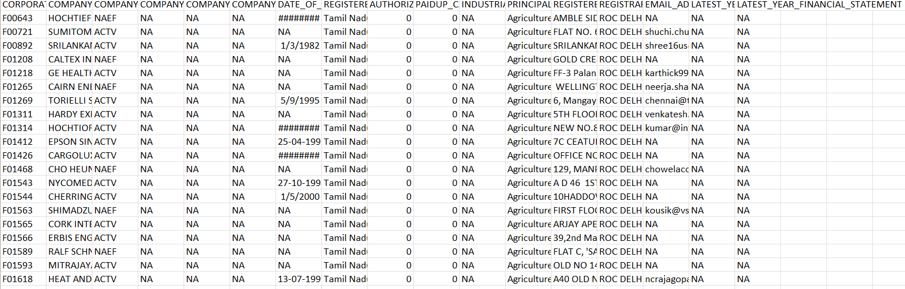
Data Integration:
Merge or combine data from multiple sources into a single dataset, ensuring that the data is consistent and compatible.
Data Formatting:
Ensure that the data is in the appropriate format for the chosen analysis or modeling tools. This may involve converting timestamps, dates, or other data types.

Slide 7
Model Selection
Model selection is a crucial step in the process of developing machine learning models. It involves choosing the most appropriate algorithm or model architecture for a given problem, dataset, and desired outcomes. Selecting the right model is essential for achieving accurate and effective results. Here are the key steps and considerations in model selection:
Define the Problem and Objectives: Begin by clearly defining the problem you want to solve and the specific objectives you aim to achieve. Understand the nature of the problem, whether it's a classification, regression, clustering, or another type of task.
Understand the Data: Thoroughly analyze and understand the dataset you are working with. Consider the data type (structured, unstructured, time series, etc.), the size of the dataset, the distribution of data, and any data preprocessing requirements.
Select a Range of Models: Identify a range of machine learning models and algorithms that are suitable for the problem at hand. This may involve choosing algorithms for supervised learning (e.g., decision trees, random forests, neural networks), unsupervised learning (e.g., k-means, hierarchical clustering), or other specific tasks

Slide 8
ROC curve explanation
A Receiver Operating Characteristic (ROC) curve is a graphical representation used to evaluate the performance of a binary classification model. It displays the trade-off between the model's true positive rate (sensitivity) and its false positive rate (1 - specificity) across different classification thresholds. ROC curves are widely used in machine learning and diagnostic medicine to assess the performance of models that distinguish between two classes, such as positive/negative, spam/ham, or disease/healthy.
Here's an explanation of the key components of an ROC curve:
True Positive Rate (TPR) or Sensitivity: This is the proportion of actual positive instances (class 1) correctly predicted as positive by the model. In medical terms, it's often referred to as "sensitivity" or "recall." Mathematically, TPR = TP / (TP + FN), where TP is the number of true positives (correctly classified positives), and FN is the number of false negatives (positives incorrectly classified as negatives).
False Positive Rate (FPR) or 1 - Specificity: This is the proportion of actual negative instances (class 0) incorrectly predicted as positive by the model. Mathematically, FPR = FP / (TN + FP), where FP is the number of false positives (negatives incorrectly classified as positives), and TN is the number of true negatives (correctly classified negatives).

Slide 9
Few key characteristics of an ROC curve:
A random classifier: A random or purely chance classifier would produce a diagonal line from the bottom left corner to the top right corner, representing a 45-degree line with an area under the curve (AUC) of 0.5.
A perfect classifier: An ideal classifier would produce an ROC curve that rises vertically along the y-axis (TPR) before moving horizontally along the x-axis (FPR). This perfect classifier would have an AUC of 1.0.
Area Under the Curve (AUC): The AUC is a scalar value that quantifies the overall performance of the classification model. It represents the probability that the model will rank a randomly chosen positive instance higher than a randomly chosen negative instance. An AUC of 0.5 indicates a random classifier, while an AUC of 1.0 represents a perfect classifier.

Slide 10
ROC curve visualization
Calculate TPR and FPR:
For a range of classification threshold values (e.g., from 0 to 1), calculate the corresponding TPR and FPR.
The TPR is calculated as TP / (TP + FN), where TP is the number of true positives and FN is the number of false negatives.
The FPR is calculated as FP / (FP + TN), where FP is the number of false positives and TN is the number of true negatives.
Plot the ROC Curve:
Plot the calculated TPR on the y-axis and the FPR on the x-axis.
The ROC curve will be a line that connects these points, showing how the TPR and FPR change as the classification threshold varies.
Include the Diagonal Line:
Plot a diagonal line from (0, 0) to (1, 1). This line represents the performance of a random classifier, and the ROC curve should ideally be above this line.
Label Key Points:
Label key points on the ROC curve, such as the point where TPR equals 1 and FPR equals 0 (the top-left corner), and the point at the intersection of the ROC curve and the diagonal line.

Slide 11
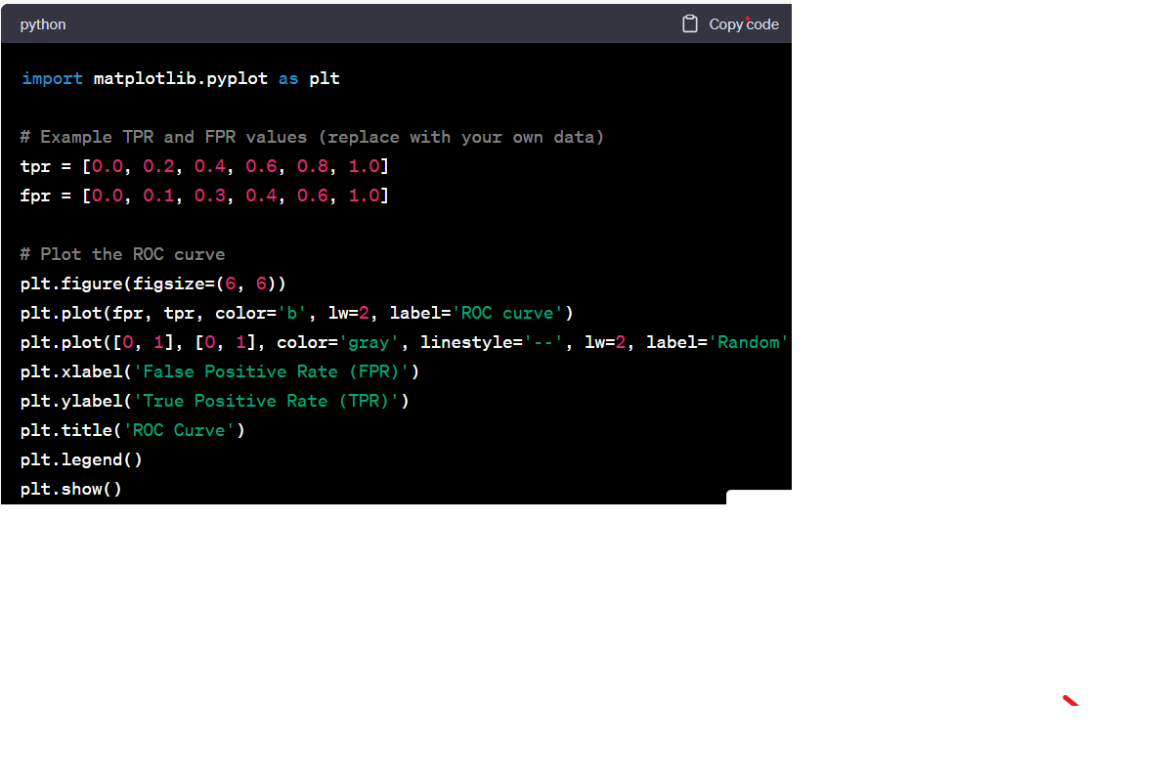
Calculate and Display AUC:
Calculate the area under the ROC curve (AUC) to quantify the overall performance of the classification model. The AUC represents the probability that the model ranks a randomly chosen positive instance higher than a randomly chosen negative instance.
Display the AUC value on the ROC curve plot.
Visualize the ROC Curve:
You can use various plotting libraries, such as Matplotlib in Python, to create the ROC curve plot.

Slide 12
Model performance
Model performance refers to how well a machine learning or statistical model performs in making predictions or classifications. It's a critical aspect of assessing the quality and effectiveness of a model for a particular task. Evaluating model performance is essential to determine if the model meets the requirements and objectives of a given project. There are various metrics and techniques used to measure and assess model performance, depending on the type of problem (classification, regression, clustering, etc.). Here are some common aspects and methods for evaluating model performance:
Accuracy: Accuracy is a simple and commonly used metric for classification problems. It measures the proportion of correctly predicted instances out of the total number of instances. However, accuracy may not be suitable for imbalanced datasets.
Precision and Recall: Precision measures the accuracy of positive predictions, while recall (sensitivity) measures the model's ability to identify all relevant instances. These metrics are particularly important in situations where false positives or false negatives have different implications.

Slide 13
Recommendations
Understand the Basics: Before diving into ROC curve analysis, ensure you have a strong understanding of the fundamentals, including what TPR, FPR, and AUC represent.
Choose an Appropriate Threshold: ROC curves are generated by varying the classification threshold. Select a threshold that aligns with your specific objectives. A lower threshold may emphasize recall (sensitivity), while a higher threshold may prioritize precision.
Know Your Problem Type: Be aware of the type of classification problem you're dealing with (binary or multiclass), as ROC curves are typically used for binary classification.
Evaluate AUC: The Area Under the ROC Curve (AUC) is a summary measure of the overall model performance. AUC values closer to 1 indicate better performance, while 0.5 represents random guessing.

Slide 14
Future steps
Tune Hyperparameters: If you haven't already, consider fine-tuning the hyperparameters of your model to potentially improve its performance. Hyperparameters, such as learning rates, regularization strengths, and the number of layers in a neural network, can significantly impact a model's performance.
Feature Engineering: Evaluate the feature set used for training the model. Consider whether adding, removing, or transforming features can enhance model performance. Feature engineering can be an iterative process.
Ensemble Methods: Explore the use of ensemble techniques like Random Forests, Gradient Boosting, or stacking. Ensemble models often combine the strengths of multiple base models to improve overall performance.
Data Augmentation: In the case of image or text data, data augmentation techniques can help increase the amount of training data and improve model generalization.

Slide 15
Conclusion
In conclusion, evaluating and optimizing the performance of a classification model using ROC curves is a crucial step in the machine learning process. ROC curves provide valuable insights into how well a model can distinguish between positive and negative classes across different threshold values. The key takeaways from this discussion include:

